Slide 1
Professional Issues in IT – HNDIT2403
Chapter 9: Some Common Issues in the Society

Slide 2
What We Will Cover
The Computer and Health
Digital Divide
Failures and Errors in Computer Systems
Silver Surfers
Increasing Reliability and Safety

Slide 3
The Computer and Health
Along with every profession there are risks confined to each.
Possession of knowledge of what these risks are will help to avoid most of them or to minimize their effect.
The study of man’s physical activities involved with his profession is called ergonomics where “ergon” is the Greek form for “work” and “nomos” means law.
In the creation of accessories today , it can be seen that they have been produced so as to perform the relevant task efficiently while ensuring man’ s safety and health and providing him maximum comfort.

Slide 4
The Computer and Health…
The physical pain occurs as a result of involving in the same task for a long period of time are called repetitive stress/strain injuries (RSI).
The commonest RSI among computer users is the painful condition on the palm or wrist.
This condition is called Carpel Tunnel Syndrome and while those working with the computer keyboard for long periods of time are subject to this condition, it is also aggravated by adopting the wrong position when working.
Conformity to the instructions below on the use of keyboard and the mouse will help to minimize possible elements of risk involved.
  Use of keyboard and mice produced to health standards.
  Use of a support to rest wrist.
  Keeping palms and wrists straight when typing
  Taking a proper break.

Slide 5
The Computer and Health…
The next problem that computer users face is the painful condition of the back, especially pain of the spine and neck.
The steps below can be taken to avoid them.
  The seat used should have the facility to adjust height.
  It should have the facility at the back for one to lean against
  It should contain adjustable arm supports.
  While feet should be firmly placed on the floor when seated, there should be a foot rest when the seat has to be elevated
  When seated, the back and neck should always be erect.

Slide 6
The Computer and Health…
A condition quite common among computer users is eye-related problems.
Conditions like headaches are commonly related to the eye problems.
These conditions of the eyes resulting from computer use are called computer vision syndrome (CVS).
The most common eye-related conditions are dry eyes, irritation of eyes, pain of the eyes, blurred vision and double vision.
Conditions related to eyes highly depends on Computer Screen.
The following points will help to minimize the conditions.
  Monitor should be positioned at eye-level or slightly below.
  It should be located 20-30 cm from the eye-level of the user.
  It should be possible rotate up/down and left/right as necessary, and adjusted as necessary.
  There should be facilities for the adjustment of “brightness” and “contrast” as required by user.
  Along with these it is best that one takes eye-exercises.
    Directing one’s sight objects positioned at various distances, from time to time.
    Blinking of eyes from time to time

Slide 7
The Computer and Health…
Further the followings also considered .
Ensure that the level humidity of the environment is maintained at a suitable level
Avoid unprotected electric cables drawn at random.
Avoid unmatched tables and chairs.
Maintain systematic lighting.
Maintain sound humidity control.
Take necessary steps for correct manipulation of certain accessories. (E.g.: Failure to remove properly the torner in the printer)

Slide 8
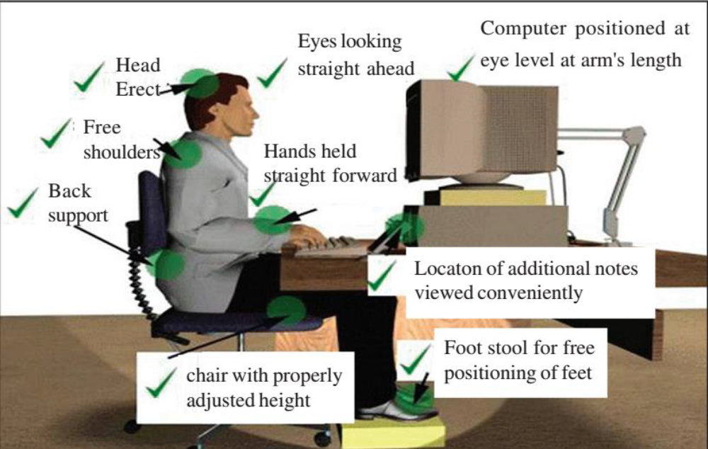
The correct posture to be adopted in using the computer

Slide 9
Digital Divide
Digital divide is a term that refers to the gap between demographics and regions that have access to modern information and communications technology, and those that don't or have restricted access.
This technology can include the telephone, television, personal computers and the Internet.
Trends in Computer Access:
  New technologies only available to the wealthy
  The time it takes for new technology to make its way into common use is decreasing
  Cost is not the only factor; ease of use plays a role
  Industrialists provide low cost options for people who cannot otherwise afford something
  Government funds technology in schools
  As technology becomes more common, the issues shift from the rich and poor to level of service

Slide 10
Digital Divide…
The Global Divide and the Next Billion Users:
Approximately one billion people worldwide have access to the Web; approximately five billion do not
Non-profit organizations and huge computer companies are spreading computer access to people in developing countries
Bringing new technology to poor countries is not just a matter of money to buy equipment;
PCs and laptops must work in extreme environments
Some people actively working to shrink the digital divide emphasize the need to provide access in ways appropriate to the local culture

Slide 11
Failures and Errors in Computer Systems
Most computer applications are so complex it is virtually impossible to produce programs with no errors
Computer professionals must study failures to learn how to avoid them
Computer professionals must study failures to understand the impacts of poor work
The cause of failure is often more than one factor
  Automated processing may not be able to recognize special cases
  Overconfidence in the accuracy of data
  Errors in data entry
  Lack of accountability for errors
  Problems in other systems and software
  Time allowed for development was insufficient
  Making significant changes in specifications after the project began

Slide 12
Failures and Errors in Computer Systems…
Some examples for system failures:
  AT&T, Amtrak, NASDAQ
  Voting system in 2000 presidential election
  Denver Airport
  Ariane 5 Rocket
High-level Causes of Computer-System Failures:
  Lack of clear, well thought out goals and specifications
  Poor management and poor communication among customers, designers, programmers, etc.
  Pressures that encourage unrealistically low bids, low budget requests, and underestimates of time requirements
  Use of very new technology, with unknown reliability and problems
Reference : Gift of Fire – 4th Edition

Slide 13
Silver Surfers
Silver surfers is the term to describe people who are aged over 50 and who use the internet on a frequent basis.
The number of older users has increased dramatically over the past several years due to their being more familiar to the technology.
Research shows that the silver surfers are spending a majority of their time using search engines and online shopping sites.
Other sources indicate that this growing trend among the older population is due to the increase in use of social networking sites to stay in touch with family members or close friends that live far away.
Studies point to Skype, Facebook, email, and instant messaging are all highlighted as commonly used, mainly because the means for communicating have become more available and even free.

Slide 14
Silver Surfers…
While the rise in internet use among the younger population has led to fears of isolation, it is argued that the increase in use for the older population has done the exact opposite.
A study was conducted that surveyed over 8,000 individuals over the age of 50 on the extent of their social-networking use.
The results showed that individuals who used the internet more consistently were 1/3 less likely to be depressed.
Depression for this age group is argued to arise from lack of mobility and feeling out of touch, but the ability to keep close contact has reversed this phenomenon - internet use is thought to increase avenues of communication and feelings of independence.
A separate study analyzed the brain function of individuals after using the internet for a week, and found that it improved nerve function in the older group.
There are a number of websites for Silver surfers including silversurfers.com, gransnet.com, 50connect.co.uk all offering advice and information plus some like Silversurfers.com a large social community.

Slide 15
Increasing Reliability and Safety
Some applications such as air traffic control are really complex and critical. Air traffic control includes computers on the ground at airports, devices in thousands of airplanes, radar, databases, communications, and so on - all of which must work in real time, tracking airplanes that move very fast.
Such systems need more reliability and safety.
Factors which affects reliability and safety of a system:
  Design and development problems
  Misrepresentation, hiding problems and inadequate response to reported problems
  Insufficient market or legal incentives to do a better job
  Re-use of software without sufficiently understanding the code and testing it
  Failure to update or maintain a database

Slide 16
Increasing Reliability and Safety…
Professional techniques to improve reliability and safety of a system:
Good software engineering
Clearly defined professional responsibility
User interfaces based on human factors and feedback and should behave as an experienced user expects
Properly assigned workload. Less workload also can lead to mistakes.
Redundancy and self-checking
Testing including real world testing with real users
Law, regulation and markets to improve reliability and safety of a system:
Criminal and civil penalties should support to provide incentives to produce good systems, but shouldn't hinder innovation
Warranties for consumer software
Regulation for safety-critical applications
Professional licensing
Taking responsibility

